Slide 1
SMART DOORBELL
Cora Bleier, Fynn Mehrens &Jeroen Steeghs

Slide 2
Table of contents
Feeling
Flowchart
Design of the Doorbell

Slide 3


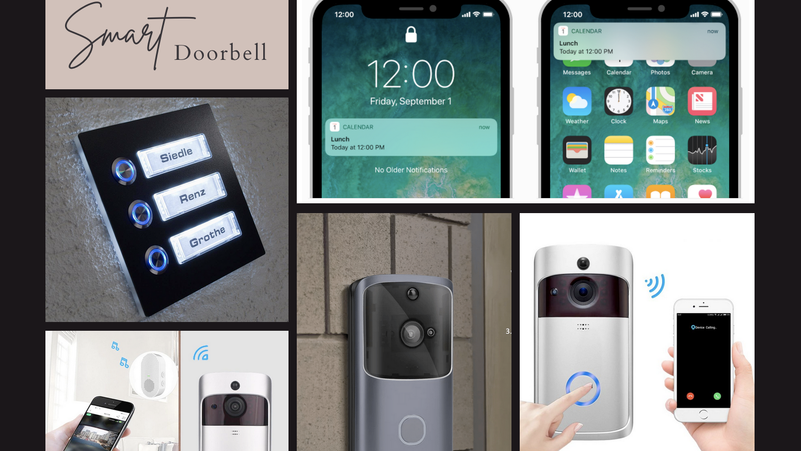
Feeling

Slide 4

Flowchart

Slide 5
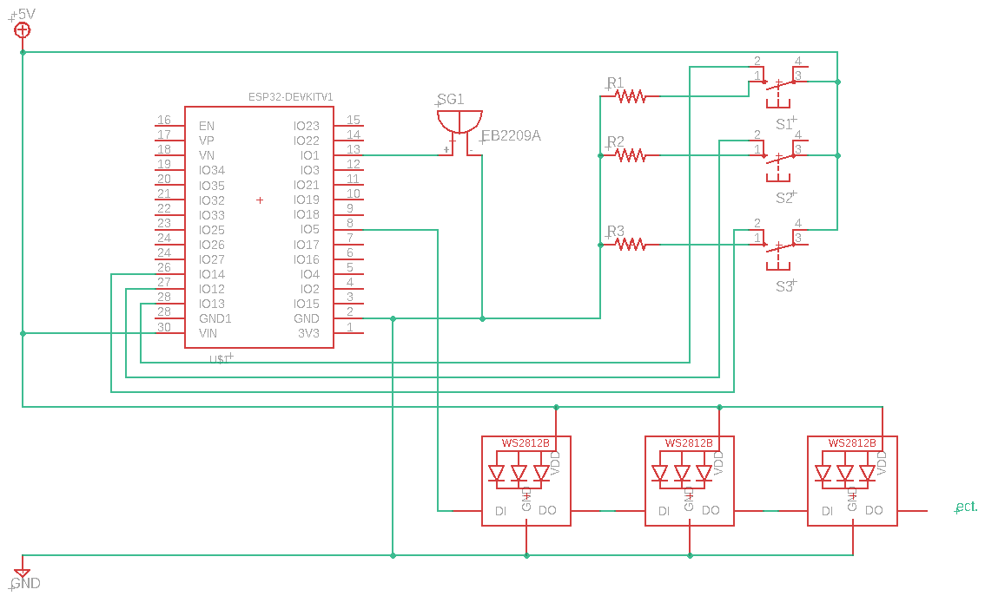
Electrical Circut

Slide 6
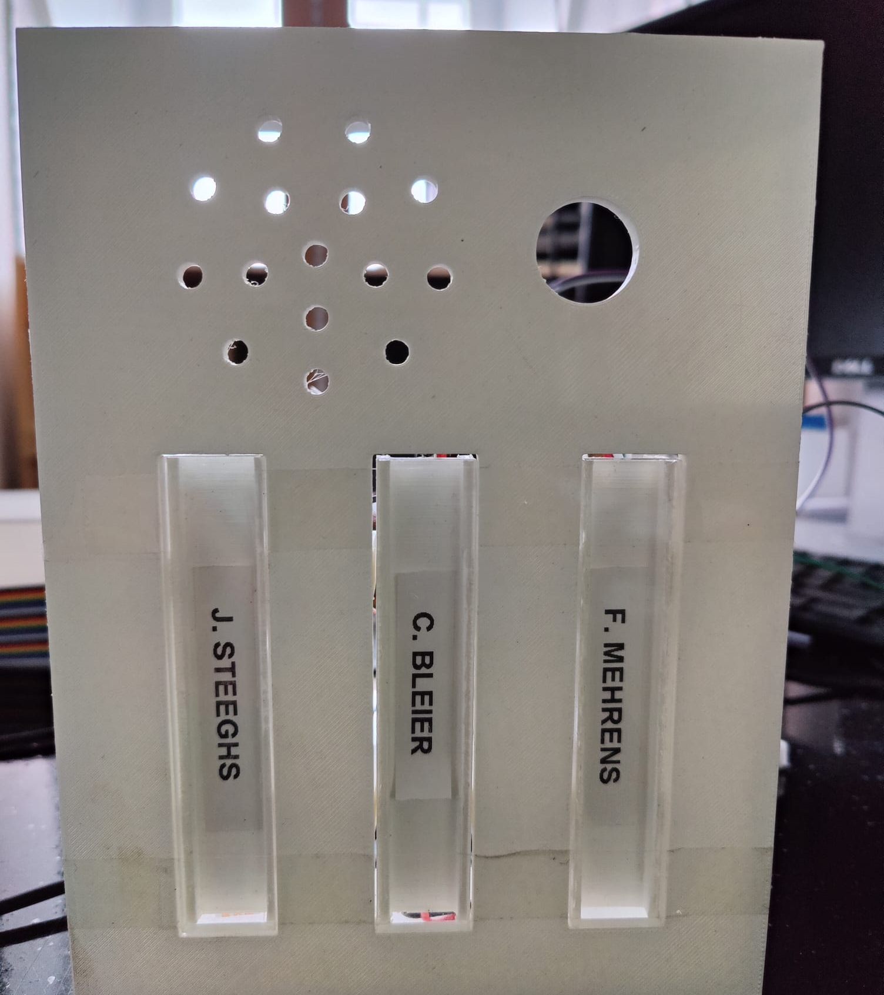
Design of the Doorbell

Slide 7
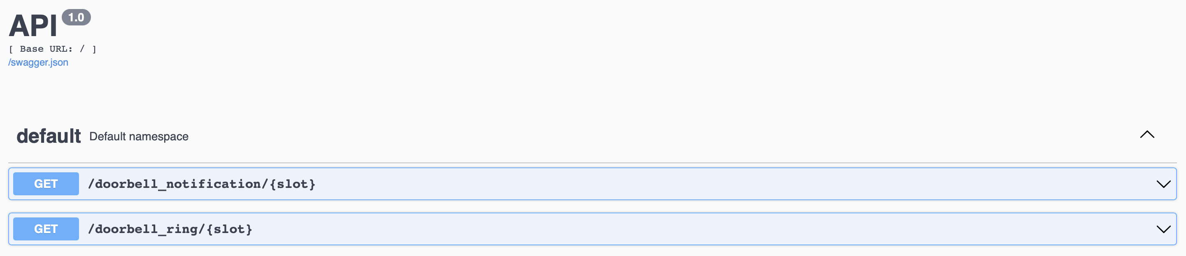
Middleware / Backend
ESP makes request to url/doorbell_ring/<int:slot>
01
Flask REST service stores the data on the device that it is hosted on
02
Mobile app requests data using url/doorbell_notifications/<int:slot>
03

Slide 8
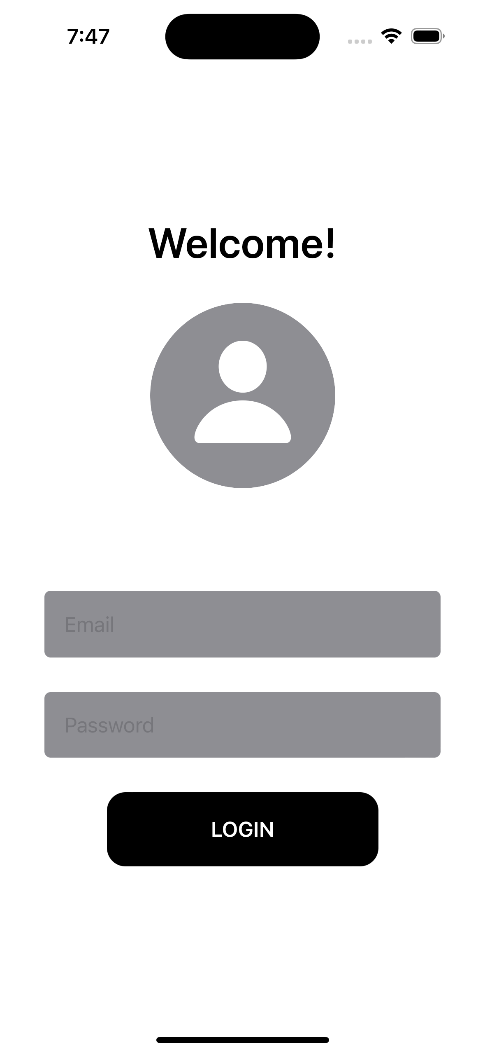
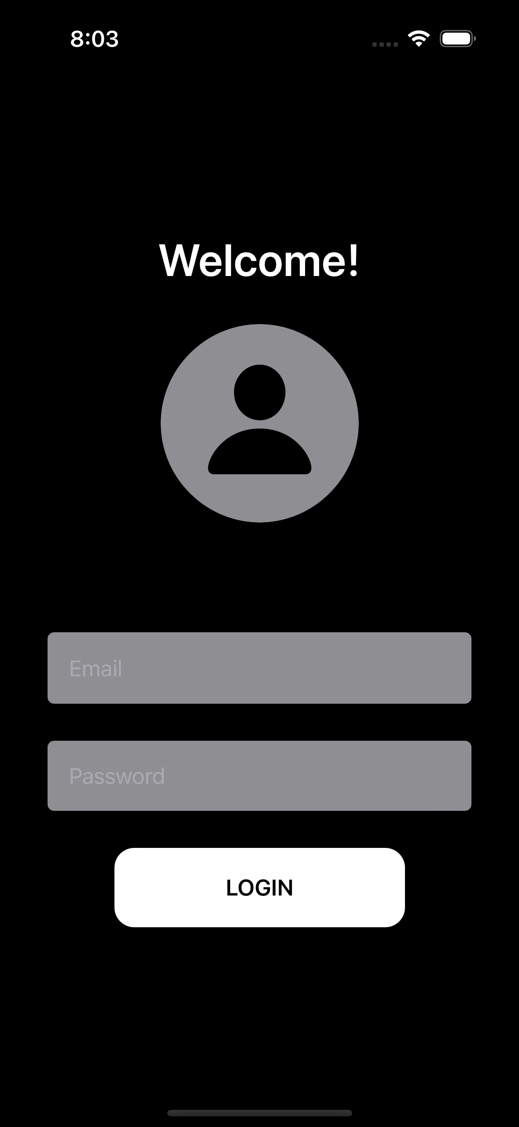
Design of the Application

Slide 9
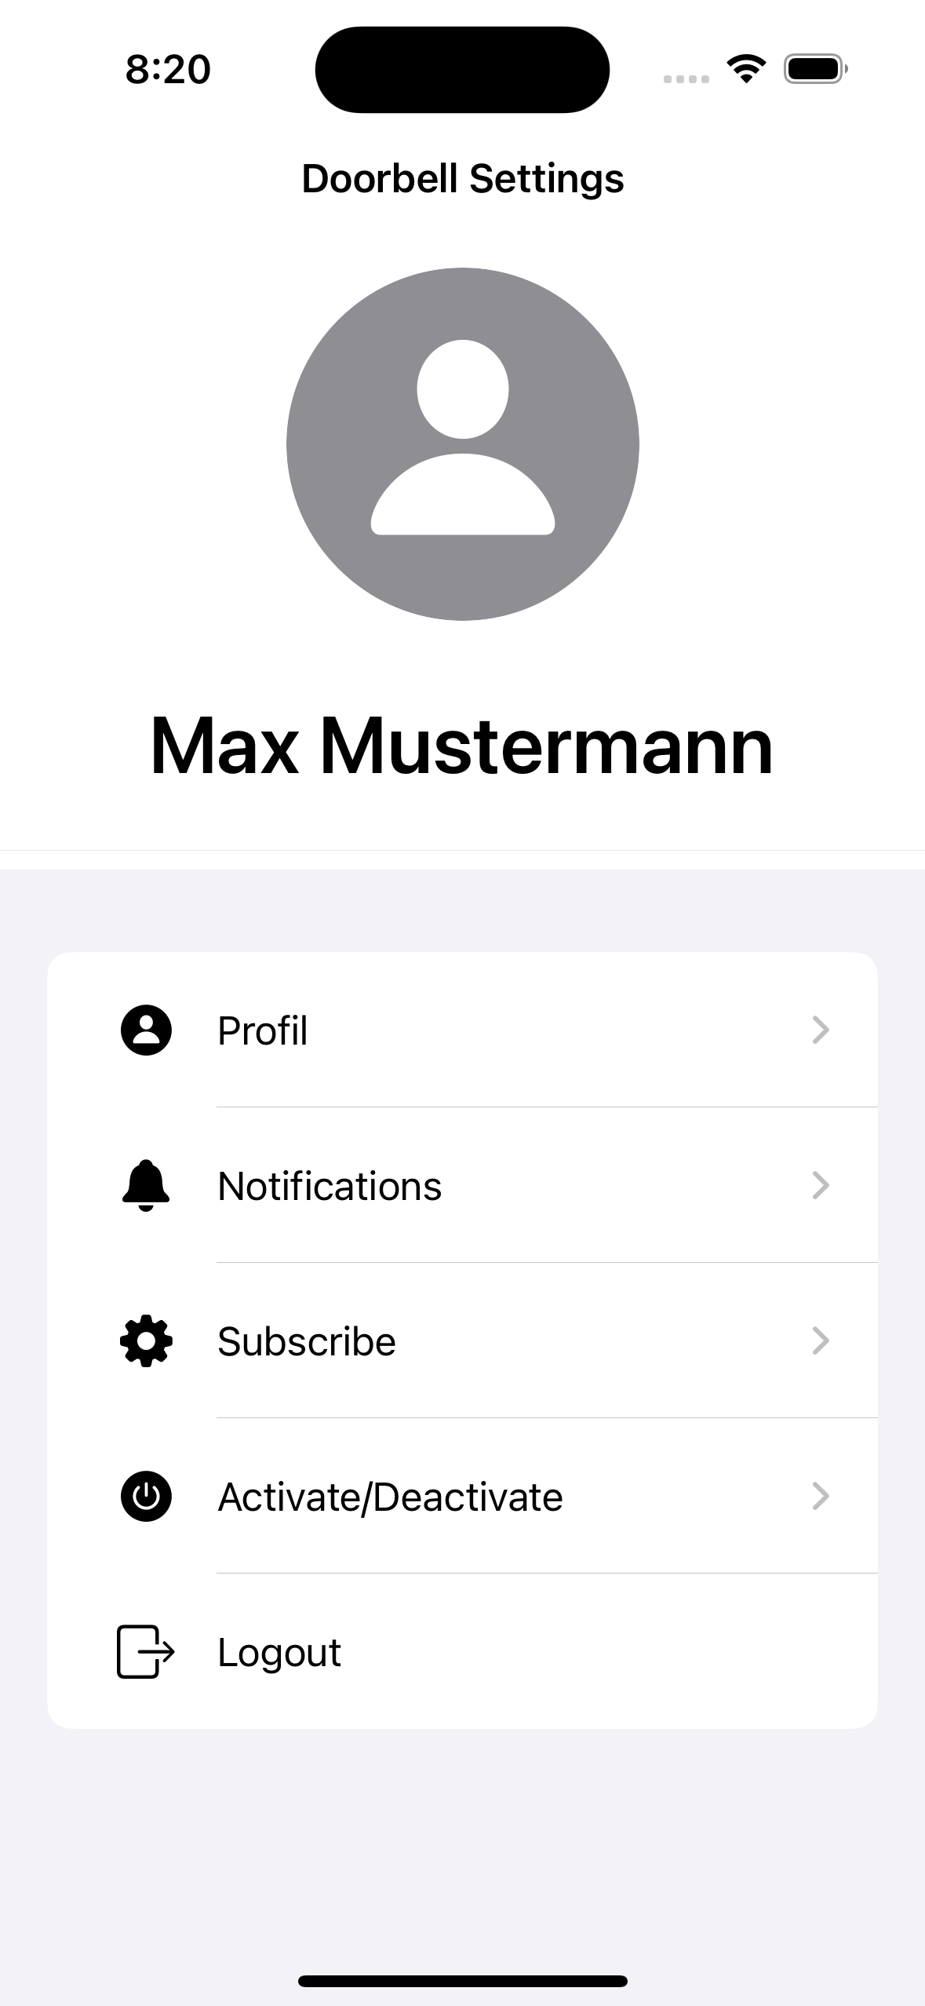
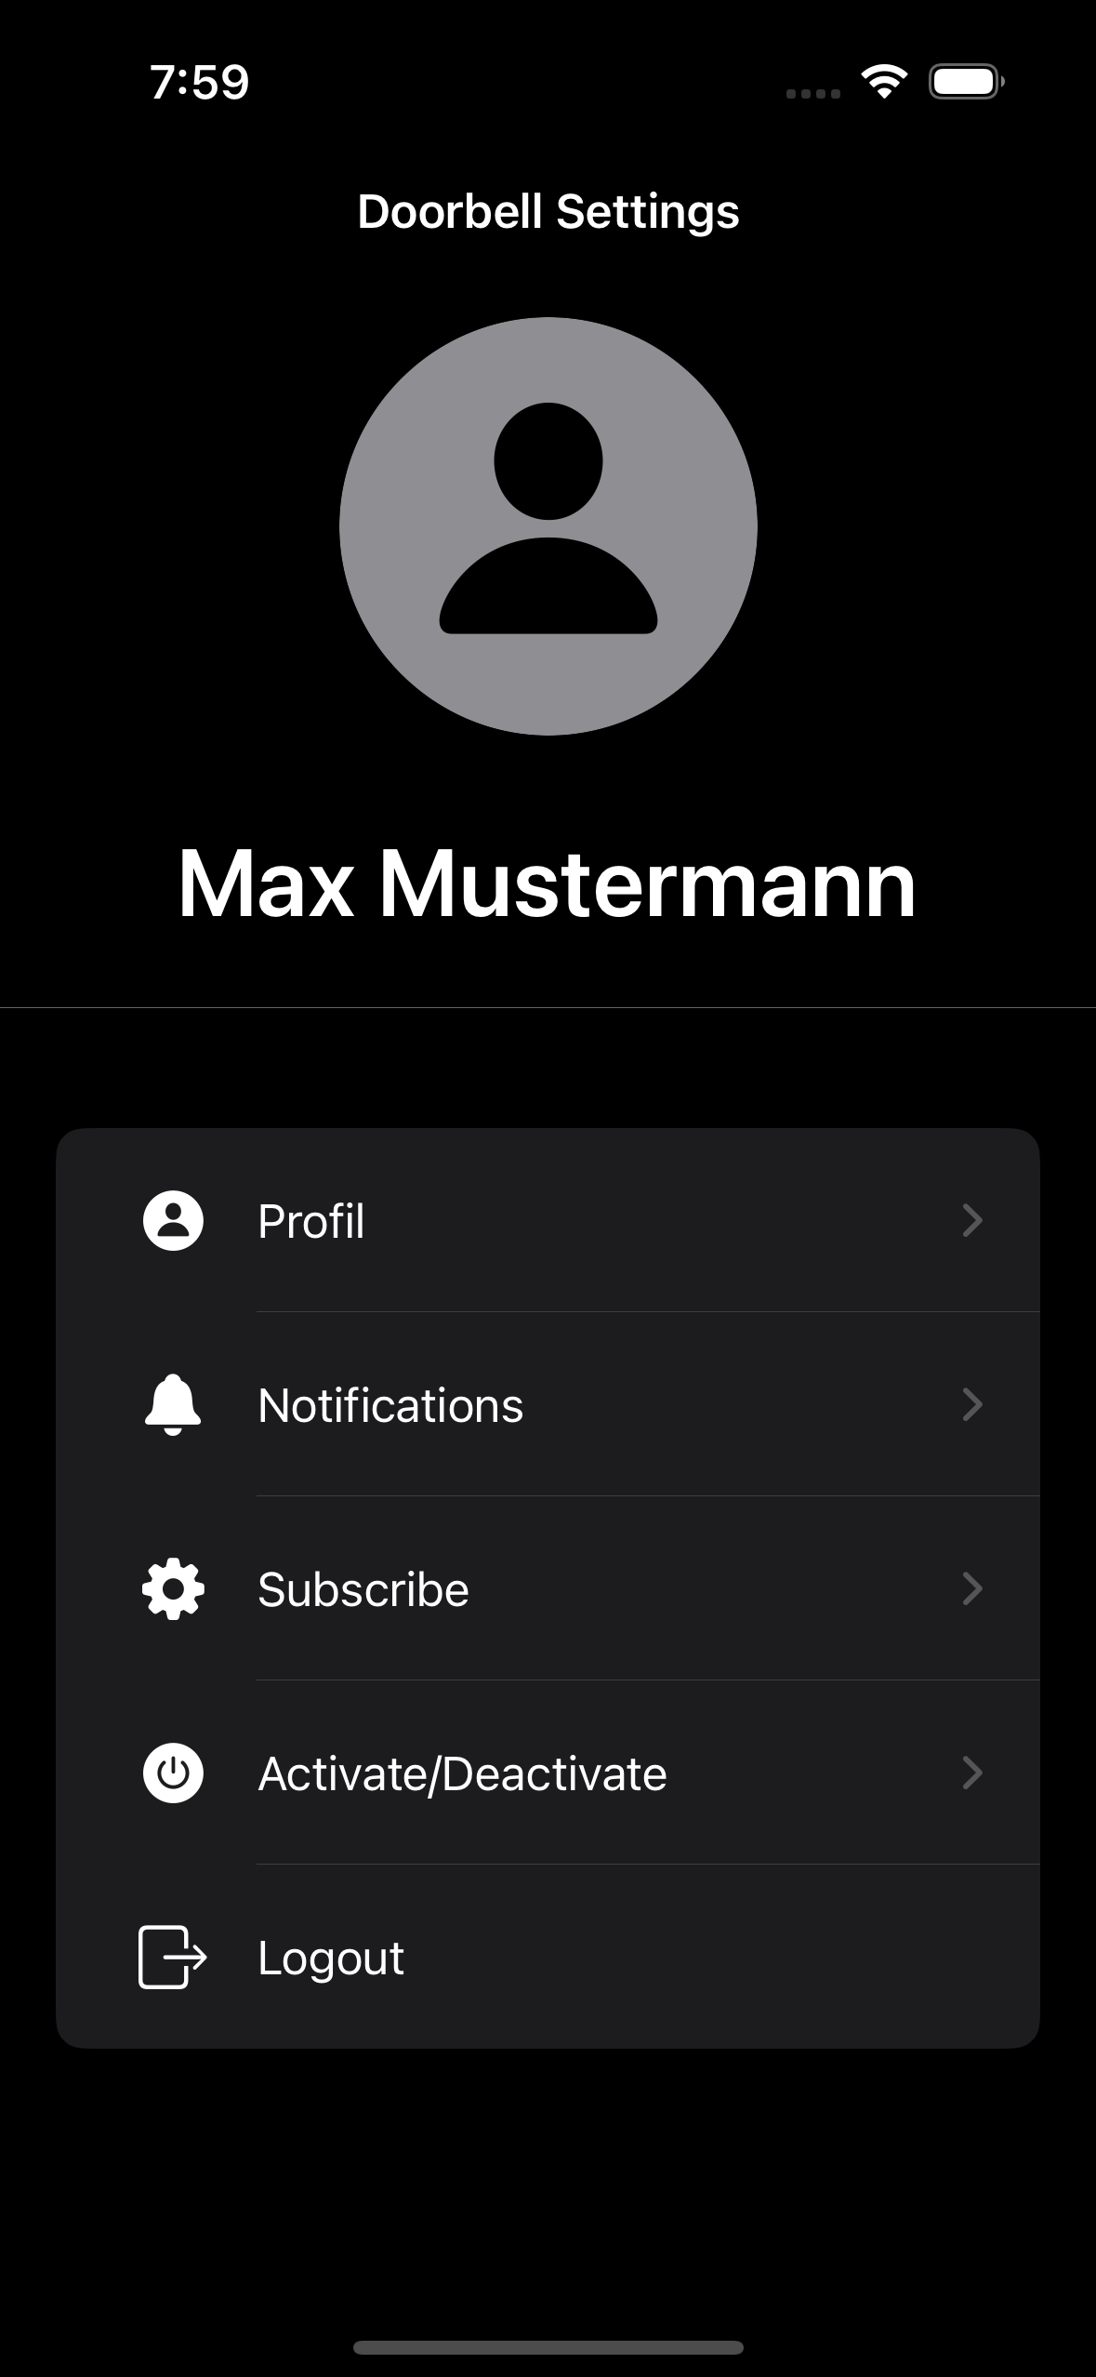
Design of the Application

Slide 10
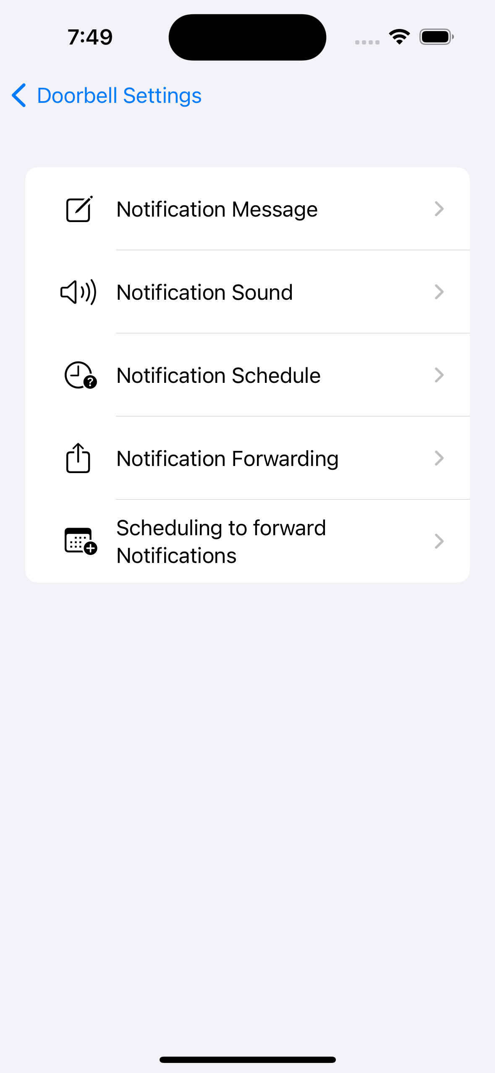
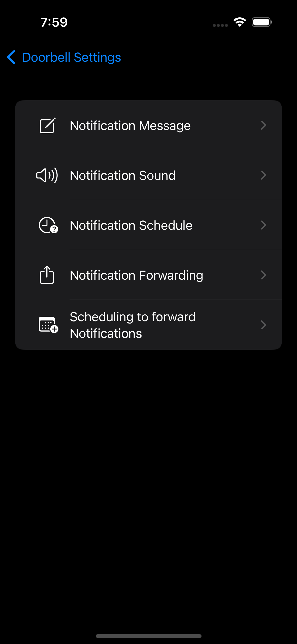
Design of the Application

Slide 11
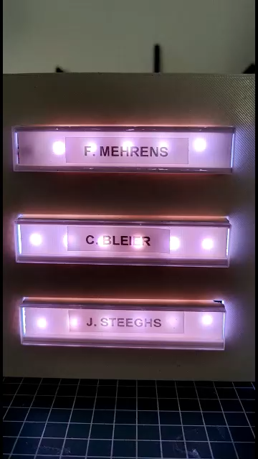
DEMO

